Slide 1
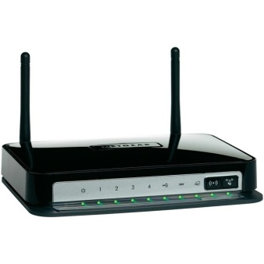
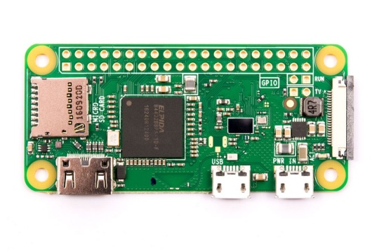


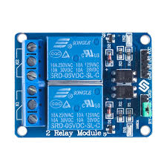


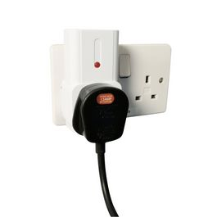
RF Plugs controlled by Alexa via Raspberry Pi
Netgear WiFi Router
Raspberry Pi Zero
GPIO 7
+5v
Gnd
+5v
Gnd
GPIO 13
GPIO 11
GPIO 15
Amazon Echo Dot
(Alexa)
Relay Module 1
Relay Module 2
RF Plugs Remote Control
off
off
Light 1
Light 2
Buttons
on
on
RF signal
RF Mains Plug 1
RF Mains Plug 2
Tony Davis issue 1.0 02.09.2017

